Slide 1
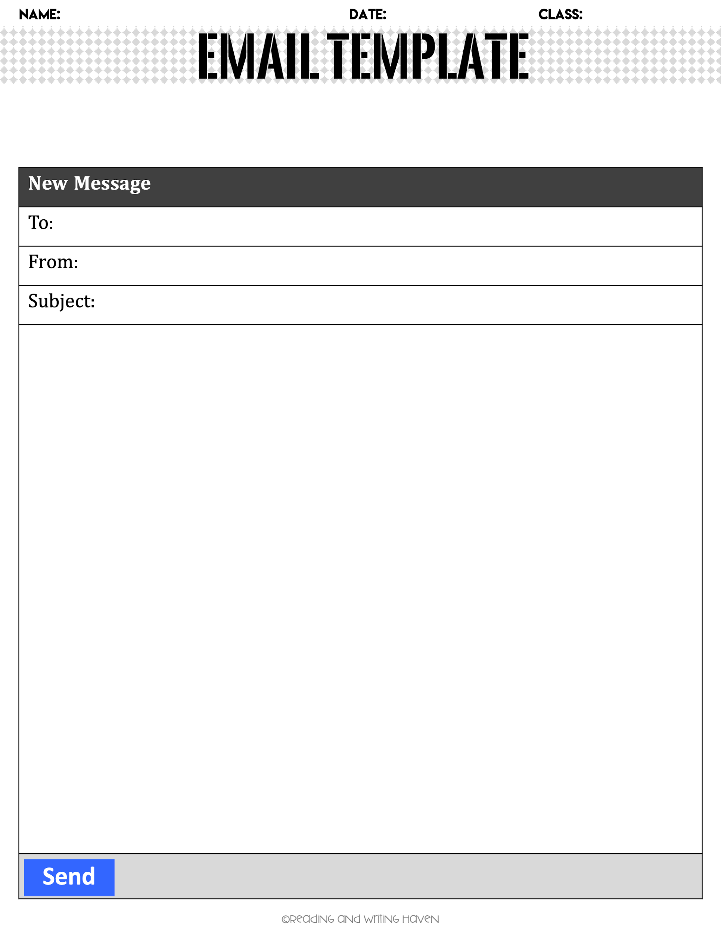
Directions: For this assignment, You will complete the following email template using information from the job advertisement and class discussion. Make sure you are using proper spelling, grammar and punctuation throughout your document.
susan.Keisner@myfpcu.com
shaneeverett007@gmail.com
Thank you for Interview on November 20th, 2023
Dear Mr./Mrs. Keisner,
I want to thank you very much for interviewing me on November 20th for the Programmer Analyst position you described. I enjoyed meeting you and learning more about Financial Plus Credit Union.
My enthusiasm for the position and interest in working for Financial Plus Credit Union was strengthened due to the interview. My Programming class at the Jackson Area Career Center, ability to debug or correct any issues discovered during beta testing, and collaboration with classmates and instructors has prepared me well for the Programmer Analyst position. I am especially interested in creating and adapting complex code, as you mentioned. I would welcome the opportunity to contribute to your company.
I enjoyed meeting you and your staff and look forward to hearing from you soon. If I can provide any additional information, please feel free to contact me by email at shaneeverett007@gmail.com or by phone at (517)740-0391
Thank you again for your time and consideration.
Sincerely,
Shane Everett

